Slide 1


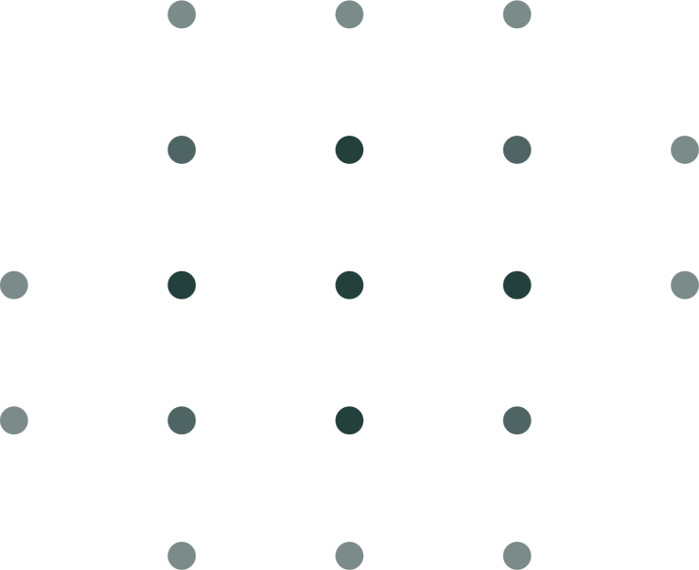



PANTHER SHUTTLE APP
https://yanarex.github.io/shuttle-app-website/
Members: Joseph Hilte, Tony Arrington, Jonathan Suo, and Chase Monigle

Slide 2



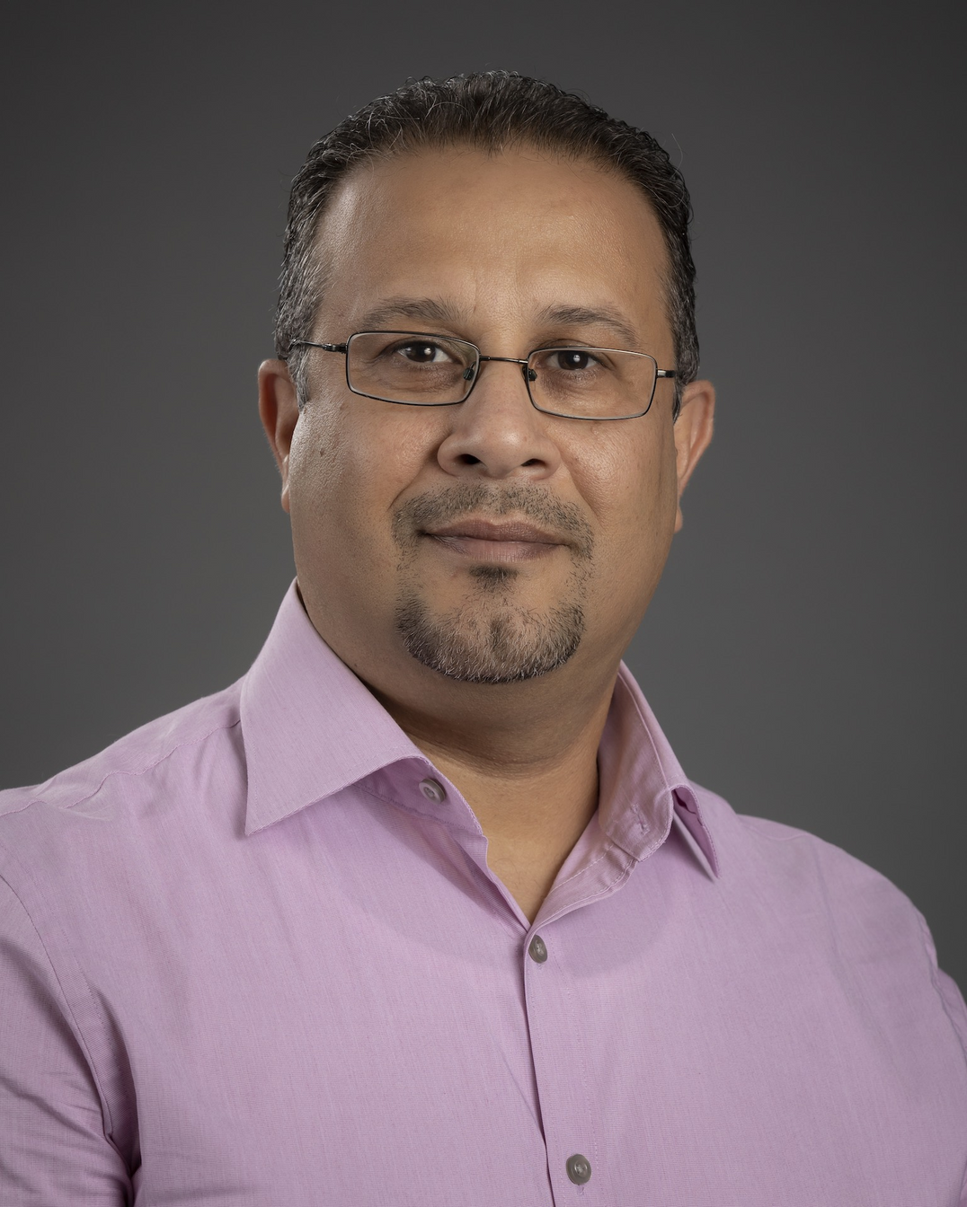





Who is involved?
Faculty Advisor: Professor Khaled Ali Slhoub
Serving as the academic mentor for this project, providing guidance on methodology, research direction, and overall academic rigor.
Client: Student Vincent Borrelli
Acting as the project user/tester, offering domain expertise, and ensuring that the outcome align with the client’s needs.

Slide 3



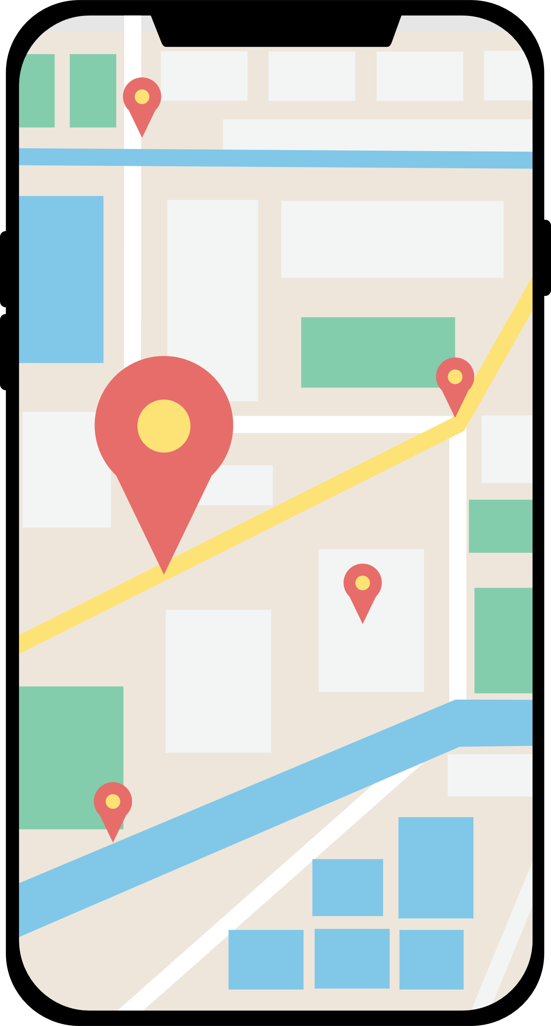



Goals/Motivation
Goals:
Motivation:
Foundations for an App for Florida Tech Students
Lack of Info about shuttle
User Friendly / Easily Available
Not enough parking on campus
Reliable Notifications
Shuttle has low use.

Slide 4



Key Features
Info
Provide a comprehensive, easy-to-navigate schedule that eliminates the need for searching through school websites.
Notification
Users can opt-in for tiered push notifications at 30, 15, and 5-minute intervals. This allows students to manage their time effectively.
Tracking
Interactive live map that visualizes the shuttle’s exact location in real-time.
Driver/Manager Interface
A dedicated interface designed specifically for drivers and transit managers.

Slide 5

Novel Features
The first software solution specifically for the unique needs of our school's shuttle system.
Introduces essential tools like live tracking and notifications that are not currently available through any other campus resource.

Slide 6

Tools
Android Studio
Google Drive/Calendar
Discord
Jira
GitHub

Slide 7



Technical Challenges
Driver Side Implementation
Focusing on ensuring the driver and student interfaces synchronize seamlessly for accurate data flow.
GPS Finalization
Currently finalizing GPS integration, which involves specialized testing to ensure high location accuracy.
General App Development
Due to the complexity of a full-scale transit app, the current goal is to produce a functional prototype by semester-end.

Slide 8
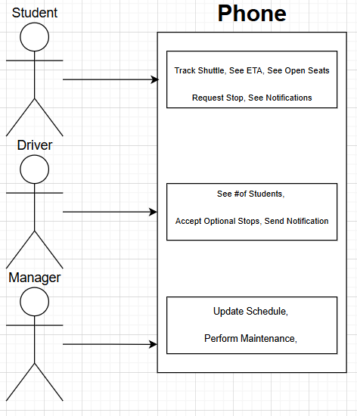


Design
System Architecture Diagram
Ensuring Driver and Student sides communicate properly.

Slide 9
Evaluation Tactics
Notification Crashing
Sending X amount of notifications to see how many the app can handle before crashing.
General Task
Testing X amount of tasks X amount of times to see both speed/reliability.
User Surveys
User Surveys from different types of users for valuable feedback.

Slide 10
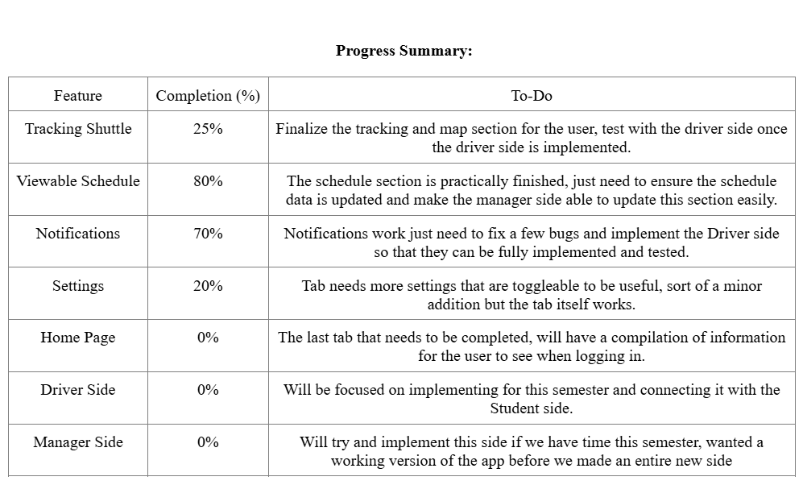

Slide 11








Project Milestones
Milestone 4
Milestone 5
Milestone 6
Work on Home Tab.
Work on Settings Tab.
Improve Mapping System.
Begin Driver Side Implementation.
Work on Driver Side Tracking.
Implement Driver Side to see # of Students at stop.
Connect Driver Side & Student Side for Notifications.
Connect Driver Side & Student Side for Tracking.
Conduct evaluation and analyze results
Create poster for Senior Design Showcase
Finalize Student Side of App.
Finalize DriverSide of App.
Implement Manager Side.
Finalize Manager Side abilities.
Test/demo of the entire system
Conduct evaluation and analyze results
Create user/developer manual
Create demo video

Slide 12
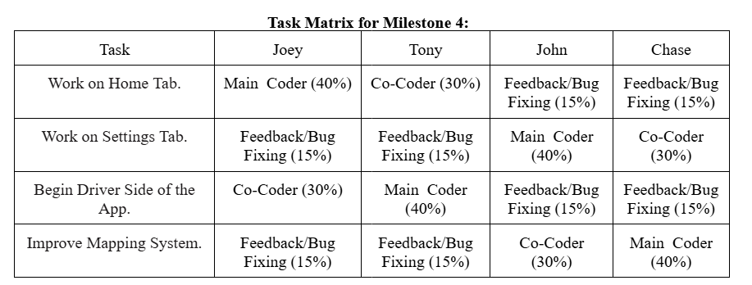

Slide 13





QUESTIONS?
Visit our website
https://yanarex.github.io/shuttle-app/

